Slide 1
RETAINING, GROWING & TRAINING CALIFORNIA’S NEXT GENERATION of MANUFACTURING
Pamela Kan President, Bishop-Wisecarver – Pittsburg, CA
Future of Work Commission -- December 12, 2019

Slide 2
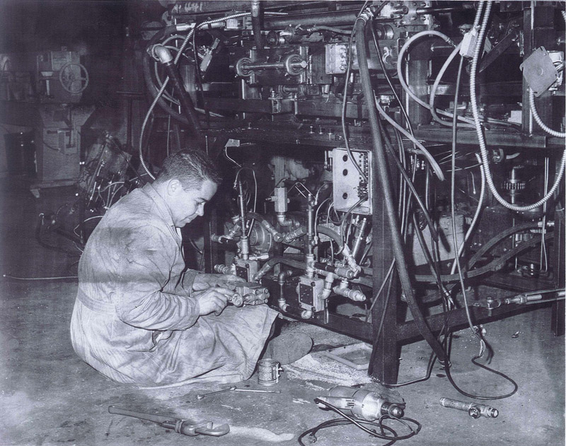
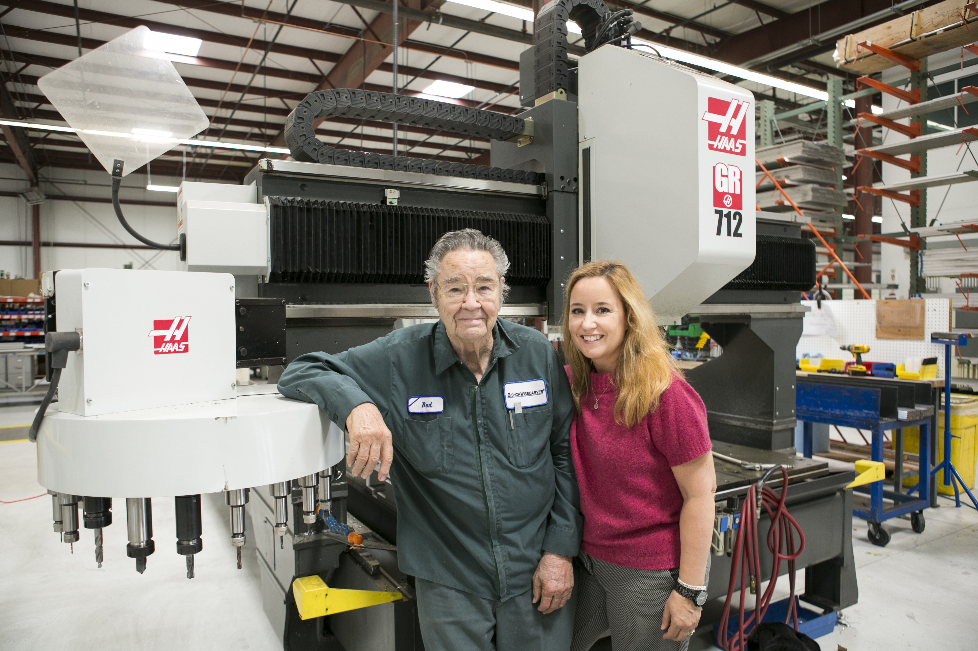
Seven Decades of California Success
ABOUT BISHOP-WISECARVER
1960s
2010s

Slide 3
Training takes time
Junior College & Community Colleges
Internal Company Training Program
Industry Specific, Often Requires Travel

Slide 4
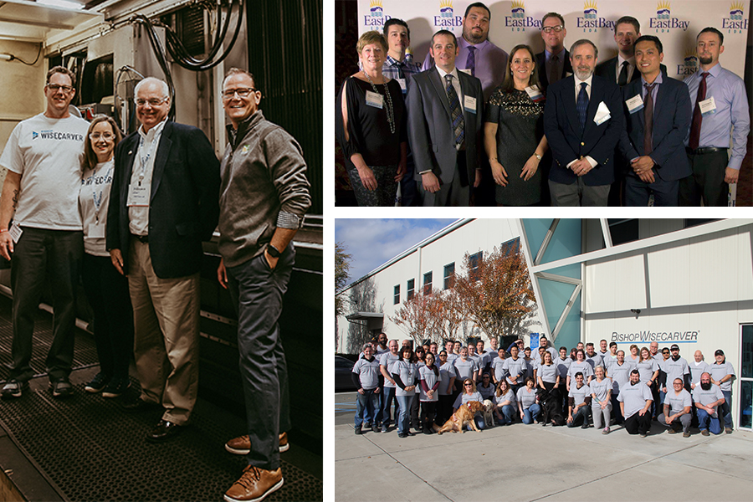
Training up

Slide 5
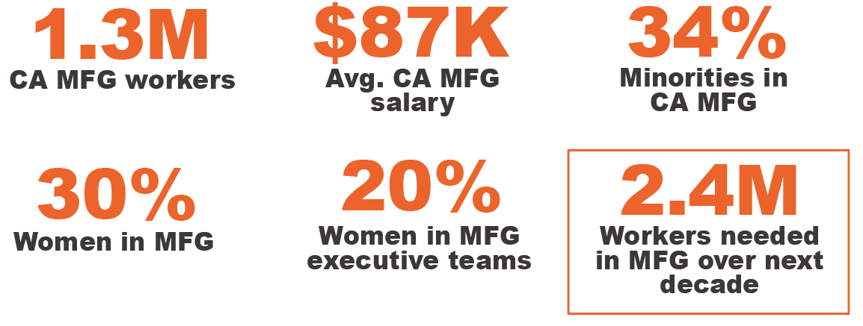
State of manufacturing

Slide 6
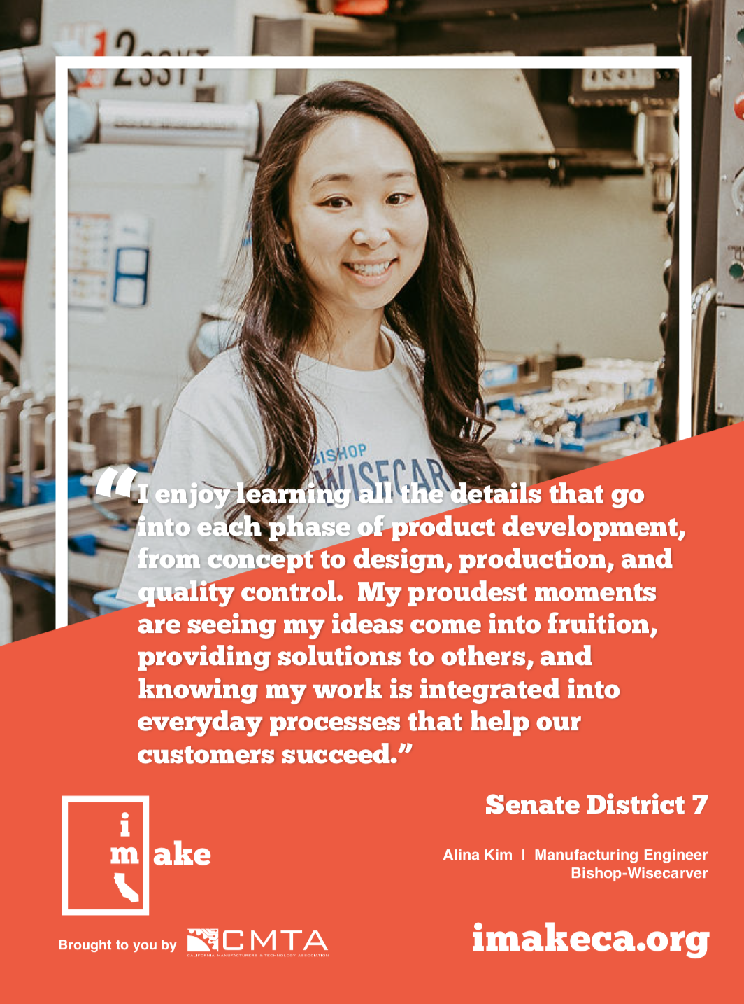
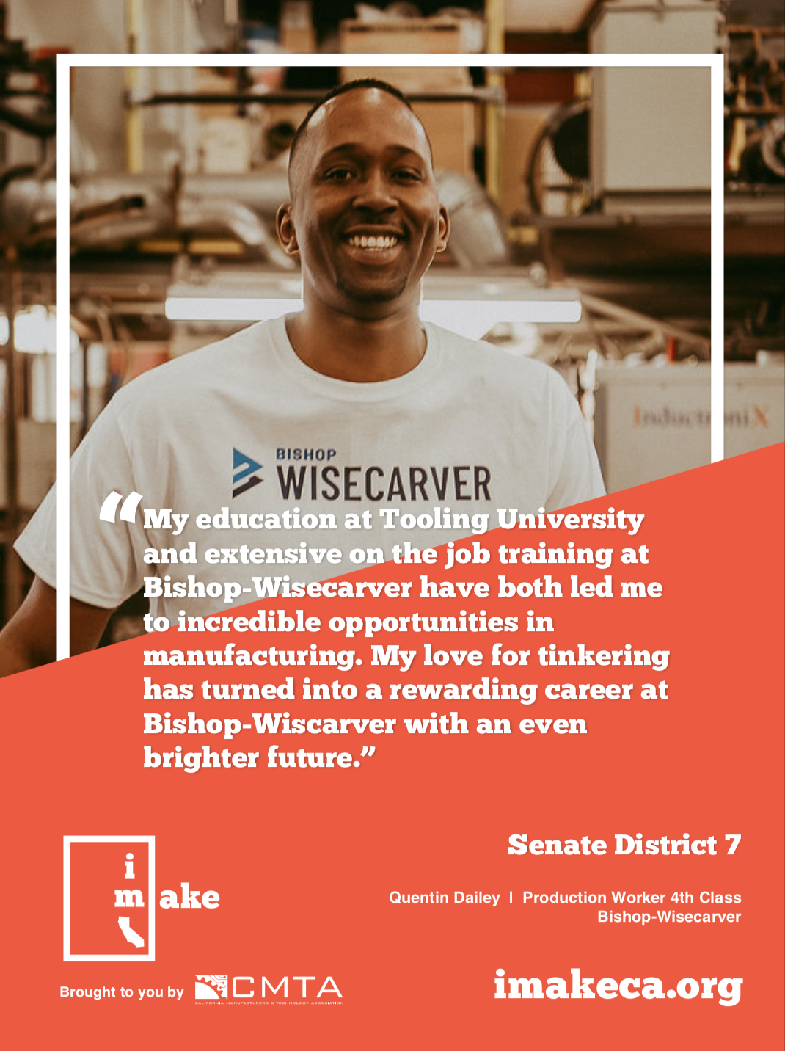
Mfg Opportunities are for Everyone

Slide 7
Capitalize on Opportunities for Women and Others in Manufacturing
Subsidize and increase models like BW’s in-house training and connections with high schools and community colleges.
Increase STEM Education.
Increase existing employment training funds by raising caps on Employment Training Panel grants for manufacturing.
Leverage events and manufacturing champions like MFG Day and Women in Manufacturing to mentor and promote manufacturing.

Slide 8
CAlifornia Has Other Operational Challenges
Work-life Balance
Need 40-hour workweek option for all employees.
Regulatory Consistency and Competitiveness
Difficult to make long term investment decisions in the state with new California-specific and costly regulations every year.
Energy Costs Create a Competitive Disadvantage

Slide 9
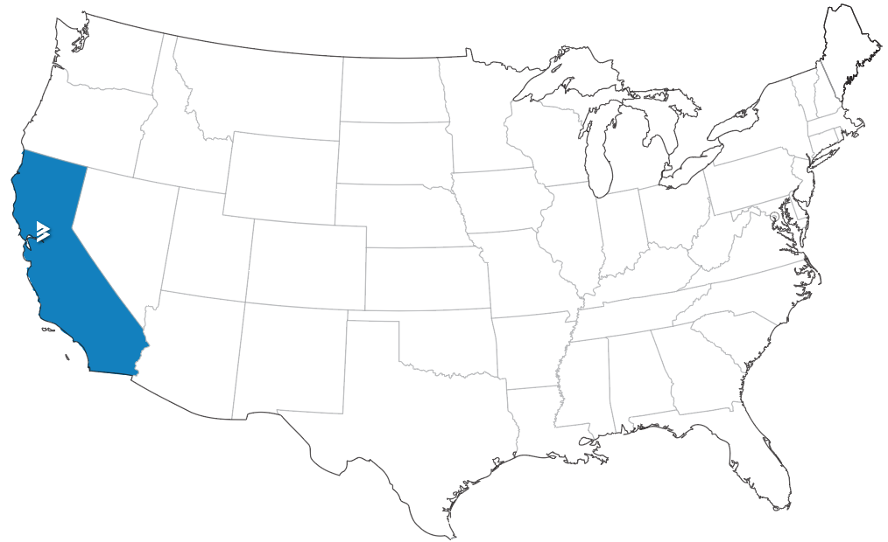
Other States Always Recruiting Us

Slide 10
Keep us competitive

Slide 11
Thank you
to all the Commissioners for your diligent efforts on the Future of Work Commission.
Please contact me with any questions At Pkan@bwc.com

