Slide 1
Data and AI: The Impact on Workers
Pauline T. Kim
Daniel Noyes Kirby Professor of Law

Slide 2
Data and AI: Impact on Workers
Monitoring and Surveillance
Bias and Discrimination
Unequal Access to Opportunities

Slide 3
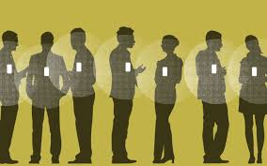
Monitoring and Surveillance
Image from Boston Globe

Slide 4
Monitoring and Surveillance
Limitations of the Law:
Employee privacy protections are limited
Sensitive information can be inferred
“Consent” may be a defense

Slide 5
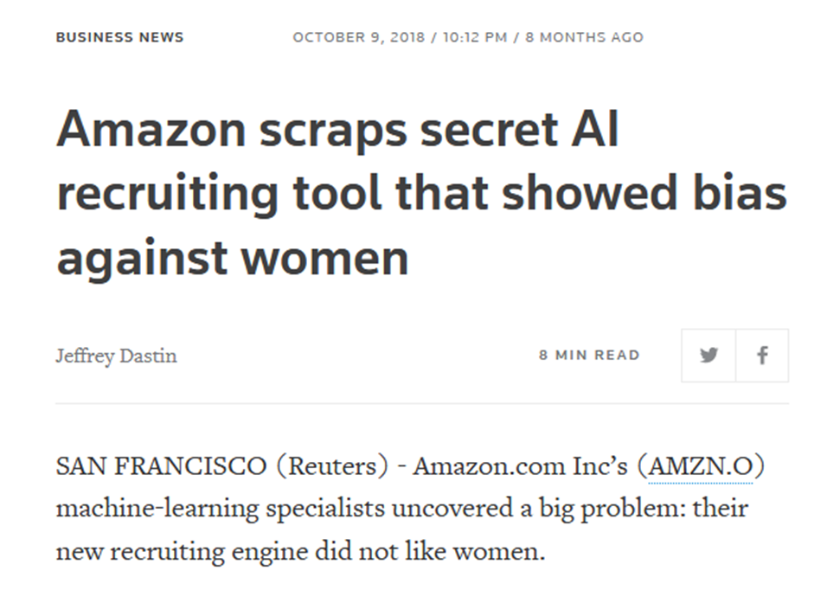
Bias and Discrimination

Slide 6
Bias and Discrimination
Limitations of the Law:
Proxies exist for protected characteristics
Identifying bias requires access to data
Evaluating employer justifications is difficult with AI

Slide 7
New Intermediaries / Unequal Access
Targeted Audience
Recipients
Ad Targeting Algorithm

Slide 8
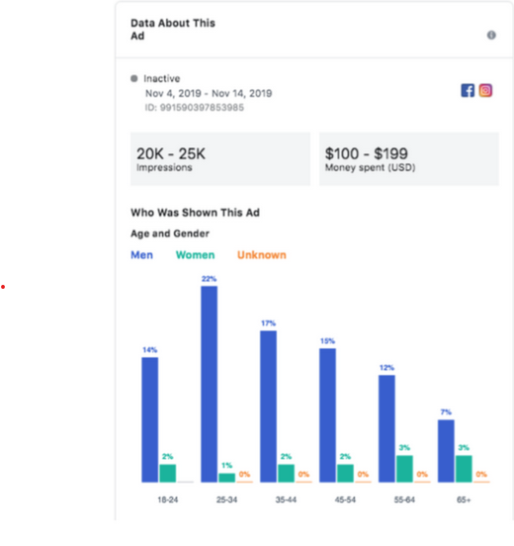
New Intermediaries / Unequal Access

Slide 9
New Intermediaries / Unequal Access
Limitations of the Law:
Uncertain liability for intermediary discrimination
Platforms claim immunity under CDA section 230

Slide 10
Moving Forward
Beware unintended consequences and premature safe harbors
Create transparency
Permit research / facilitate auditing
Diversify tech industry
Empower workers re: impact of tech

