Slide 1
Future of Work[ers]
&
Universal Family Care
Josie Kalipeni, Director of Policy and Federal Affairs

Slide 2
The number of family caregivers is dwindling
Families need all adults’ earnings to make ends meet
Women are leaving the workforce:
Older adults are aging into poverty:
7:1 3:1
64%
1 in 6
1/3
working women with caregiving responsibilities quit their jobs to provide care.
– MetLife
of adults have NO retirement savings, and of those who do, roughly half have <$10,000.
– TIME
is the projected decline between 2015 and 2050 in the ratio of people aged 45-64 to each person 80+.
– AARP
of mothers bring in at least 1/4 of family earnings; including 41% who bring in half or more.
– Center for American Progress
Notes:
Unmet care needs are driving economic insecurity and exacerbate racial and gender inequality:
What we have now is emblematic of what’s wrong and out-of-whack in our broader culture and economy:
A do-it-yourself, or pull-yourself-up-by-the-bootstraps approach to caregiving has created an inefficient, maze-like patchwork of programs
In such a biased and unequal economy, this results in perks for caregiving families who need them the least - and an alarming lack of support for THOSE who need it the most, right WHEN they need it
The very basic act of caring for our families is becoming untenable - and blowing up family budgets for more and more of us. If you do the math, it doesn’t add up.
Increased care and caregiving needs have a particularly devastating impact on women, people of color, and people with disabilities - who are already more likely to be economically insecure
[OPTIONAL: People of color spend more TIME caregiving, and more of their incomes on caregiving, than white people do.
The number of paid caregivers available to provide support won’t meet demand, and the people who do this essential work - disproportionately women of color - do not make enough wages to sustain their own families
An increasing number of us - more often than not wives and daughters and sisters - are “sandwiched” between caring for both our children and our parents]
We end up with a vicious cycle of not being able to afford care, which then causes people to make decisions that make it even harder to become financially stable. And this cycle passes down from one generation to the next.
People of color are hit the hardest
WORKFORCE are underpaid

Slide 4
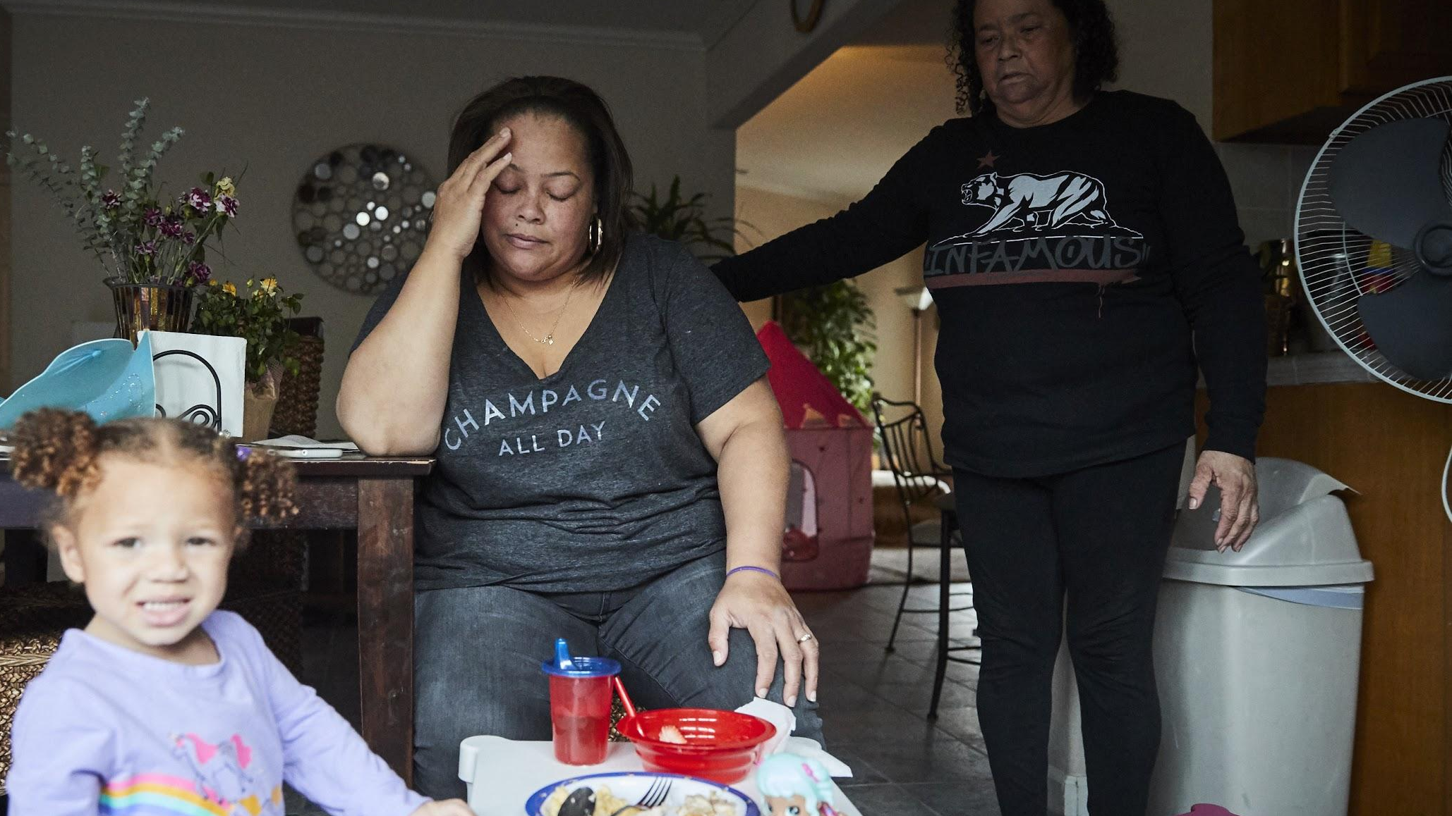
Flexibility
“The daycare closes before I’m out of work, so I’m bound to my mom to pick my granddaughter up and we’ve never had the best relationship. Sometimes she’s too sick to watch her, so I have to take off of work. I feel trapped and unable to advance my career; a new department wouldn’t be as understanding.”
– Theresa
Notes:
We’d have options that are flexible enough to meet the constraints of our lives, including fitting into our work schedules and routines. People can stay in the workforce AND meet their caregiving responsibilities.
For Theresa, a child care subsidy through UFC would allow her to enroll in daycares that match her work schedule. Relying on her mom less, removes stress, and prevents her from missing as much time at work.

Slide 5
70%
of the American workforce makes less than
Childcare can cost more than
Childcare is incredibly expensive:
$50,000
$10,000
A private room in a nursing home costs between
In the next
five years,
$80-100,000
50%
of the workforce will be caring
for an aging adult
Notes:
Unafforadable for families
Inaccessible for people who need care and people who are providing care
Unsustainable for states

Slide 7
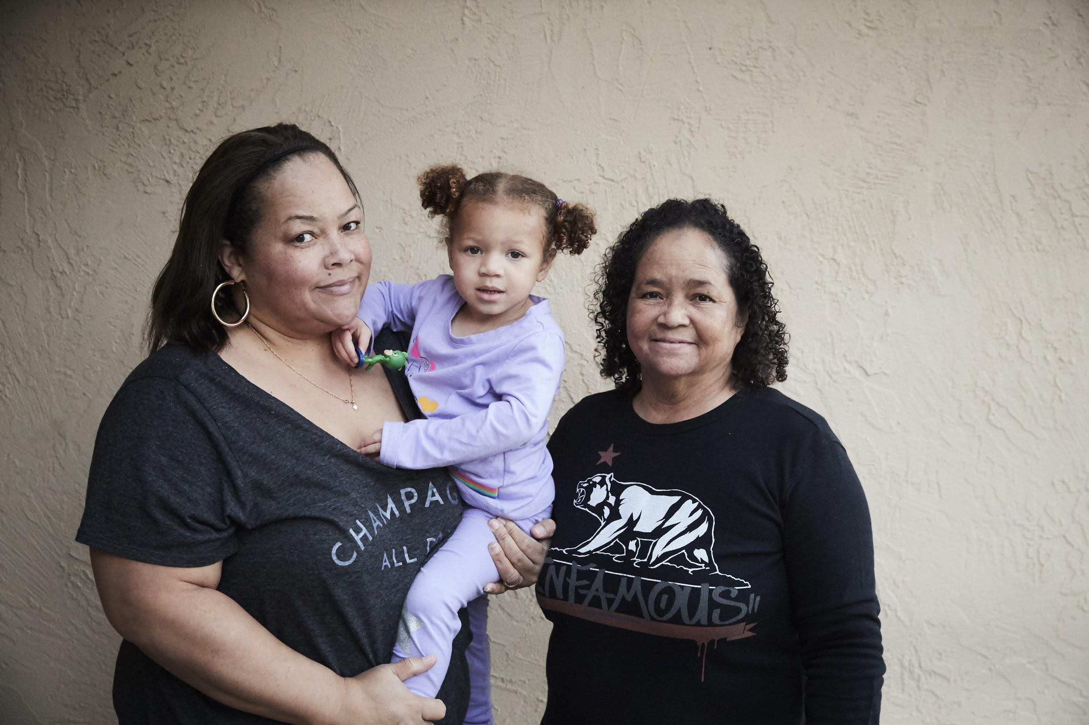
Universal Family Care Insures for 3 Care Needs
Notes:
Universal Family Care is a new social insurance program to which everyone would contribute when they are working, and from which everyone would benefit, to afford childcare, elder care, supports for people with disabilities and paid family and medical leave.

Slide 8
Pillars of a Universal Family Care program
Work is the foundation
Everyone who is working contributes and the program enables people to work
Flexible and portable
Covers people across jobs, including 1099 income, across the life course as needs change
Single access point for variety of supports
Supports change as care needs change
Invests in care workforce
Compensation, labor protections, career ladders

Slide 9
Social Insurance Structure is Key
Meaningful governance
Childcare is incredibly expensive:
New revenue
Covers the gaps
No means-testing

Slide 10
Why UFC now? Why California?
Existing safety net programs
Invests in the care workforce
4.2% > 5.3%
Total spending growth of Medicaid from 2018 to 2019, increasing burden on state Medicaid programs while still underserving people who need care.
– KFF
California is perfect
Notes:
Infrastructure, as it is, has proved that it will not support our population changes and demandings.
Medicaid: Reimbursement rates
Providers not accepting Medicaid
Medicaid waiting lists
Federal changes and threats
Solving for care and caregiving will be transformative and be a disruptive force of generational poverty

Slide 11
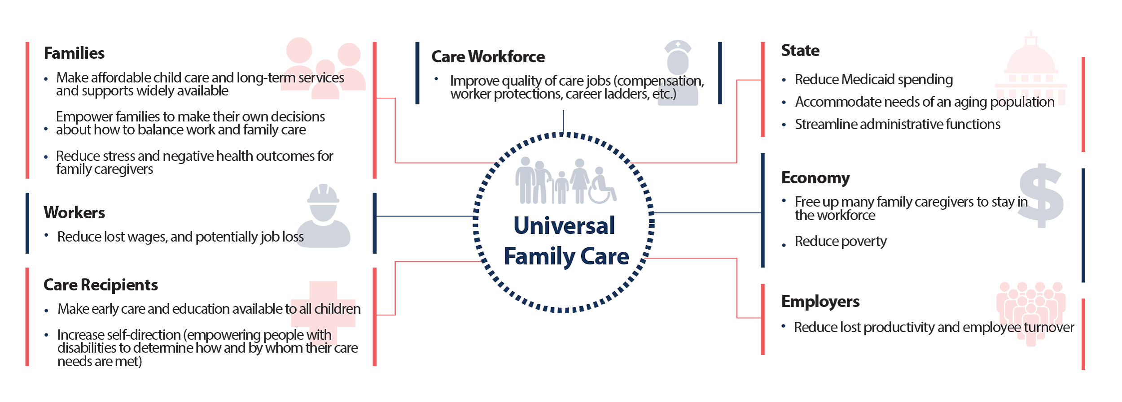
How Could UFC Benefit Society?

Slide 12
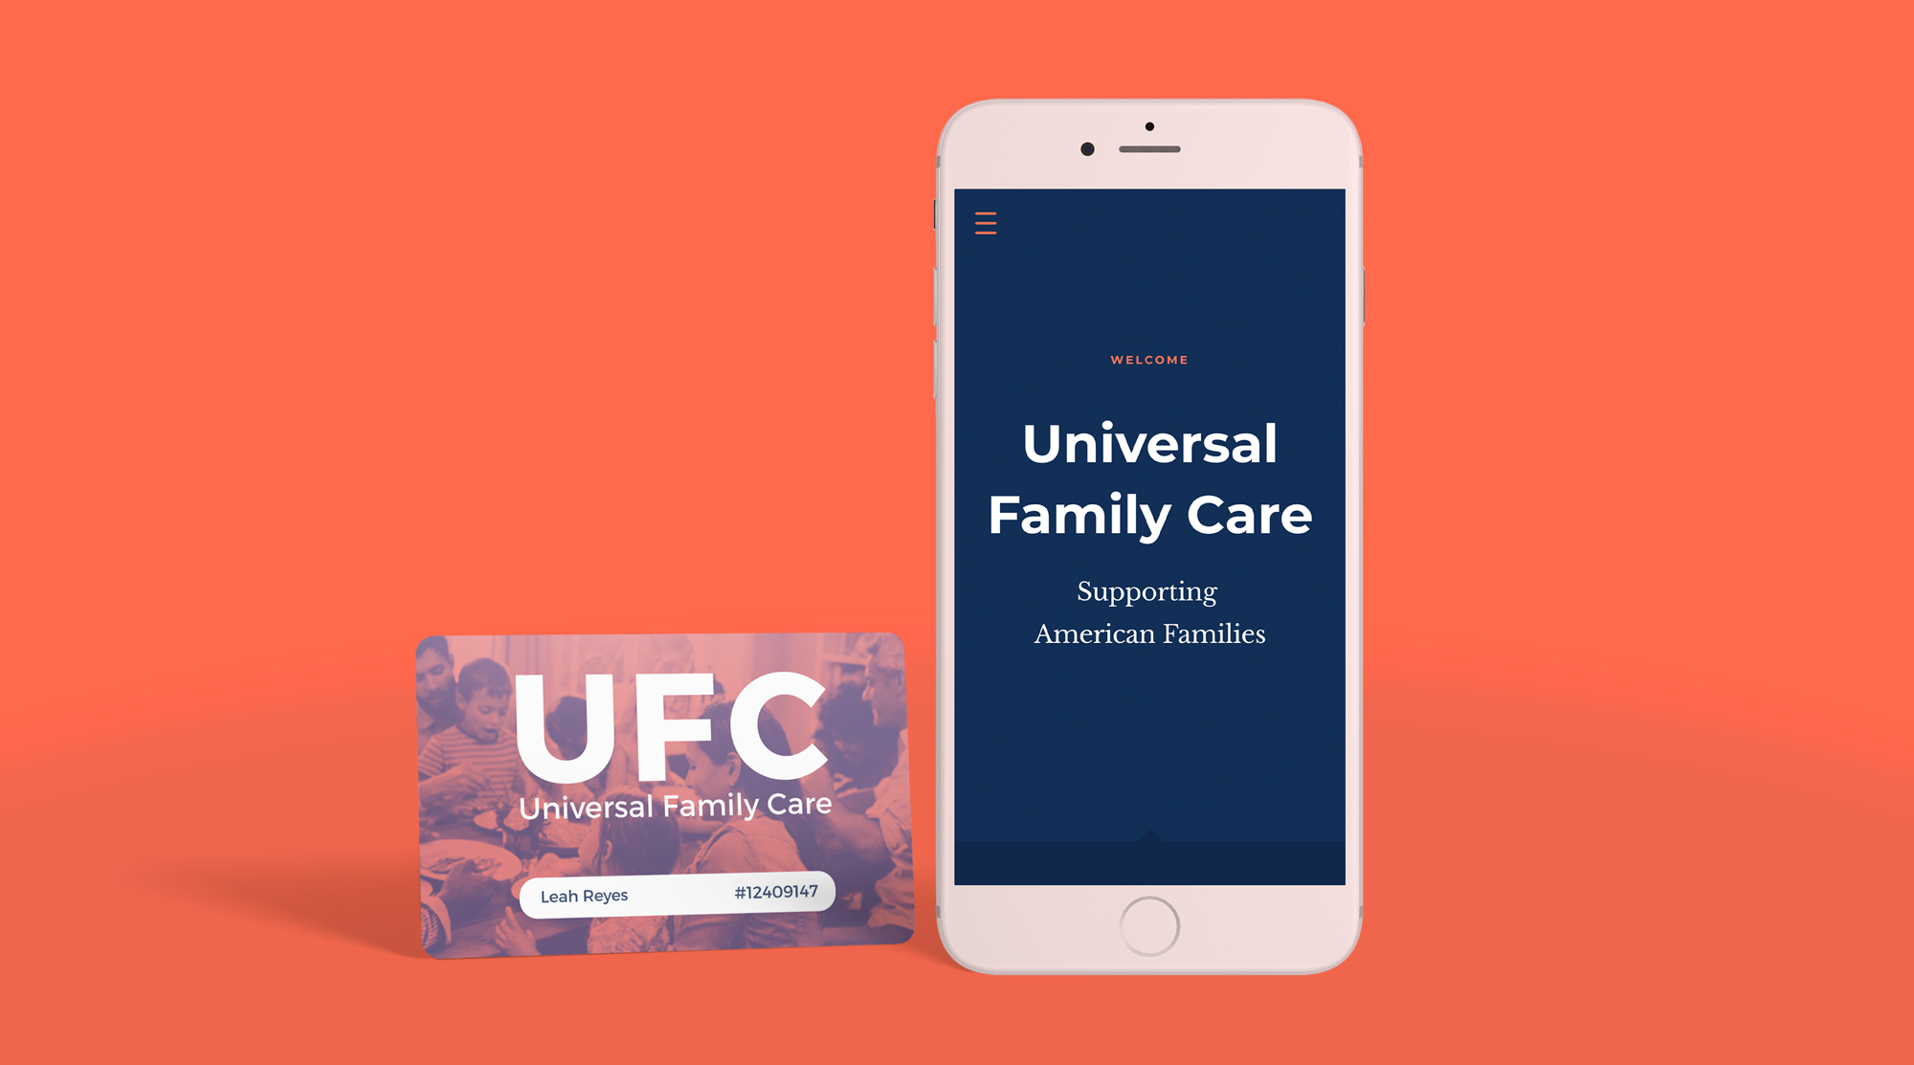
Notes:
Prototype key themes:
ID card leave-behind
Introduction to the UFC experience: navy screens
A series of stories for you to follow along with

